Slide 1


Slide 2
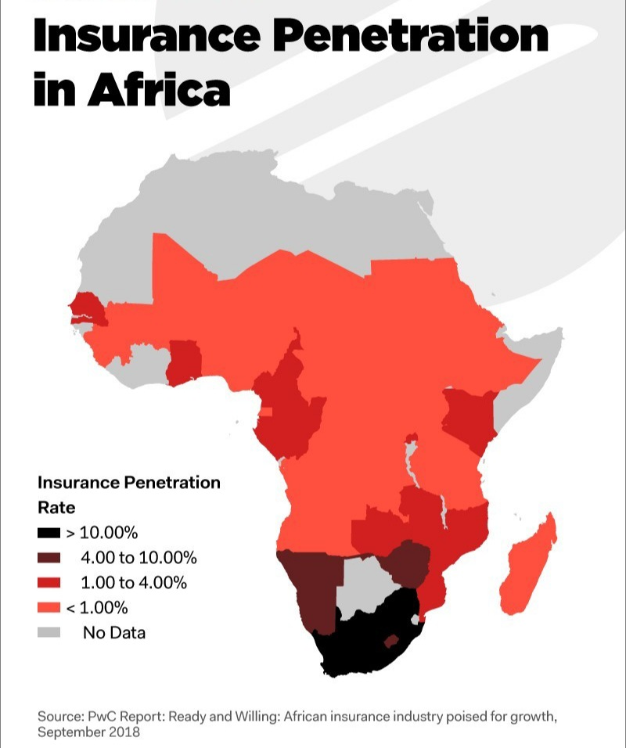
According to insurance outlooks in Africa by KPMG,Ernest and Young, PWC and Delloite.

Slide 3
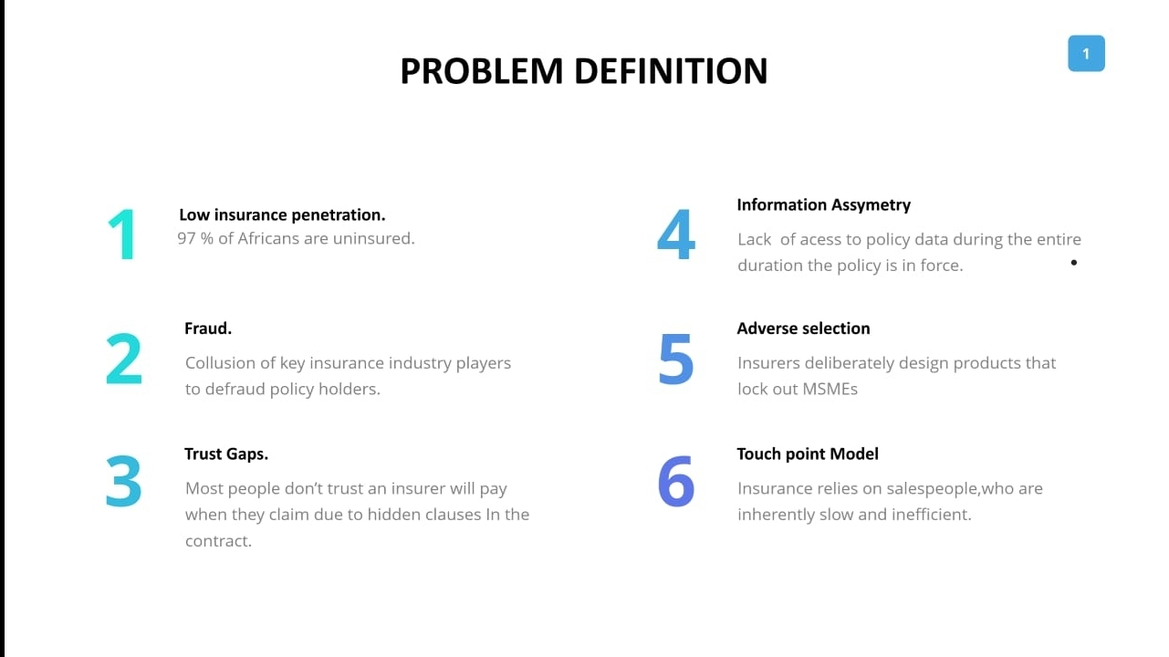

Slide 4
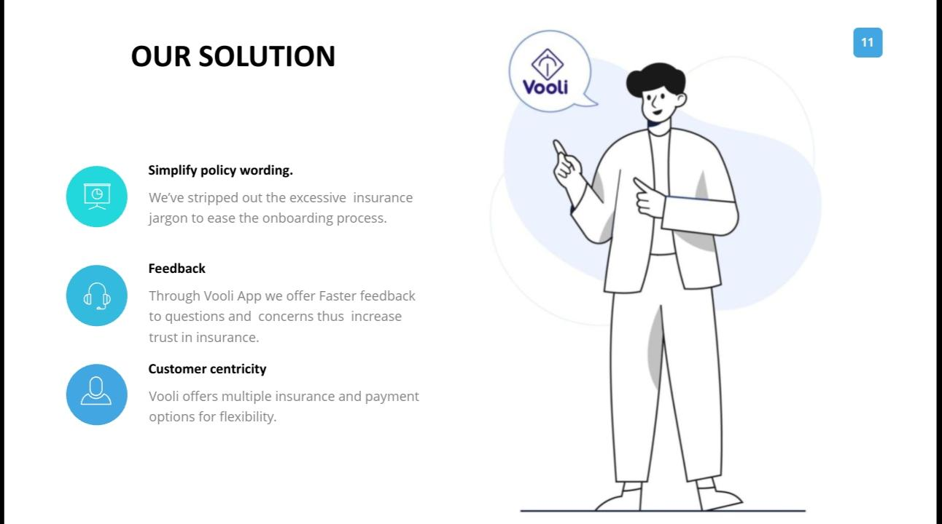

Slide 5
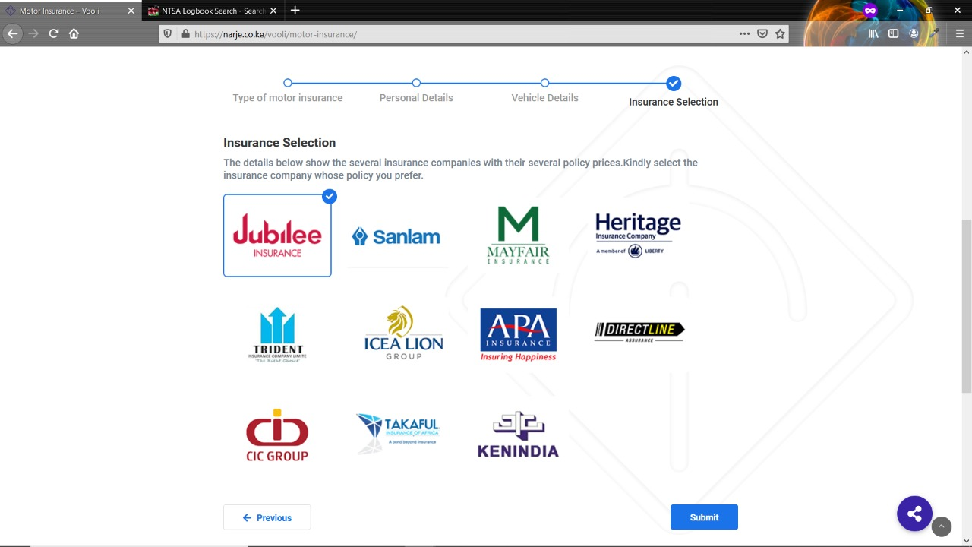

Slide 6
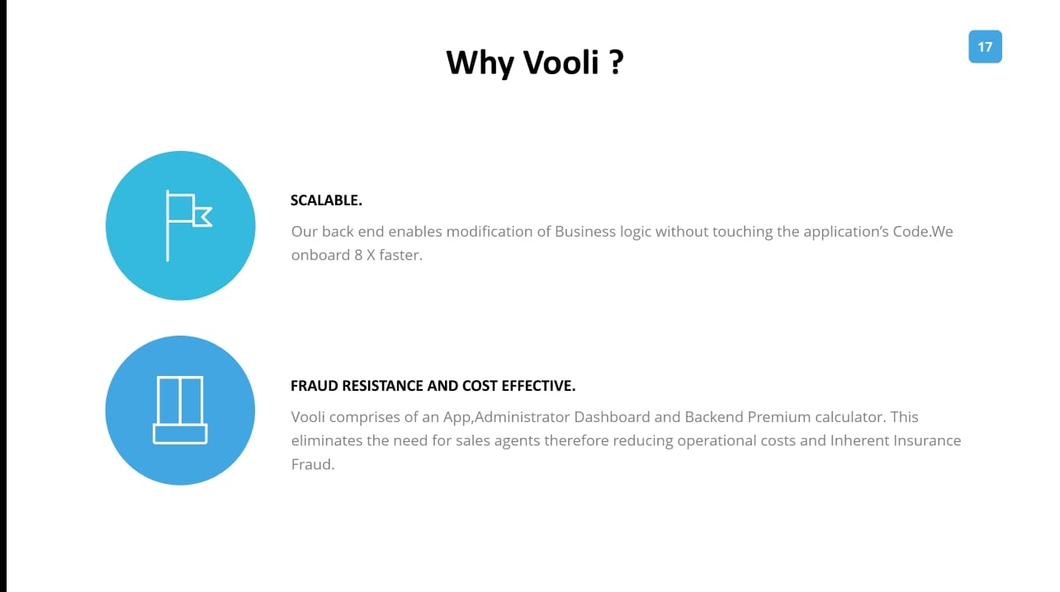

Slide 7
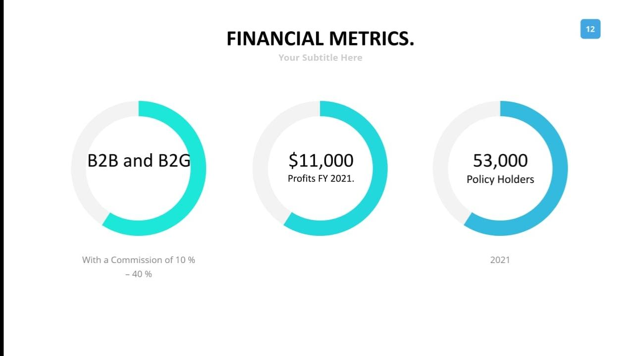

Slide 8
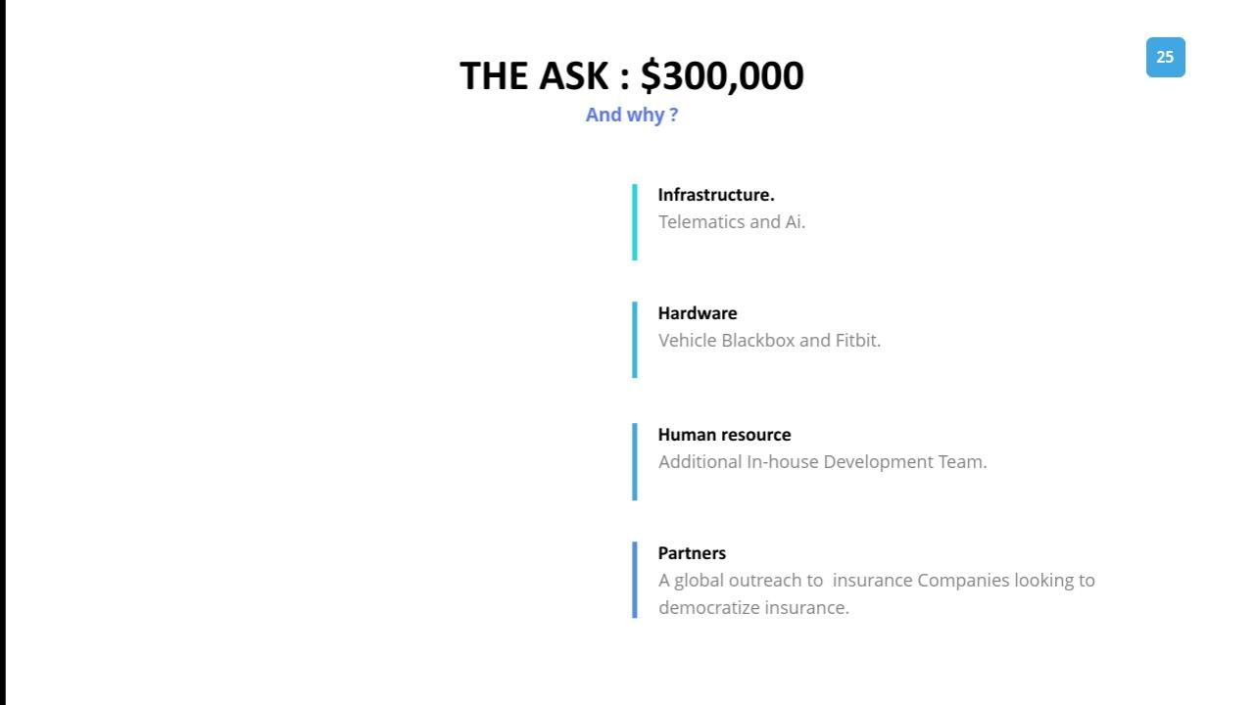

Slide 9
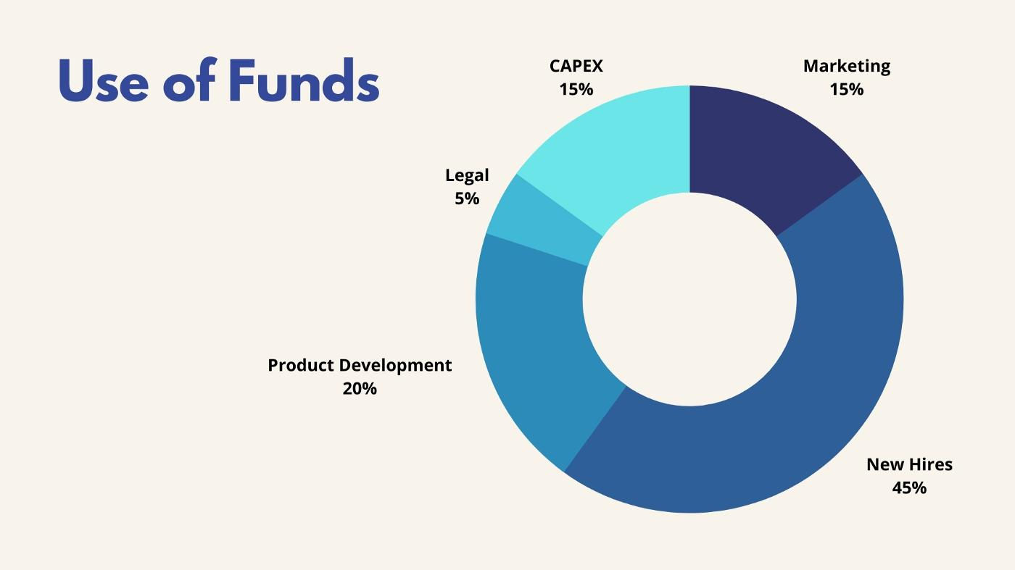

Slide 10
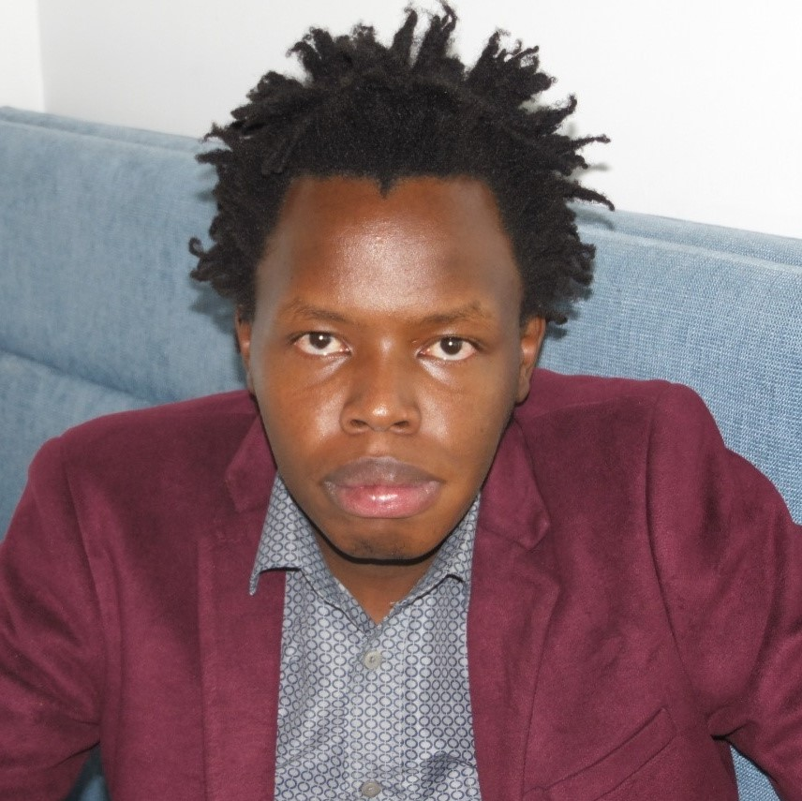
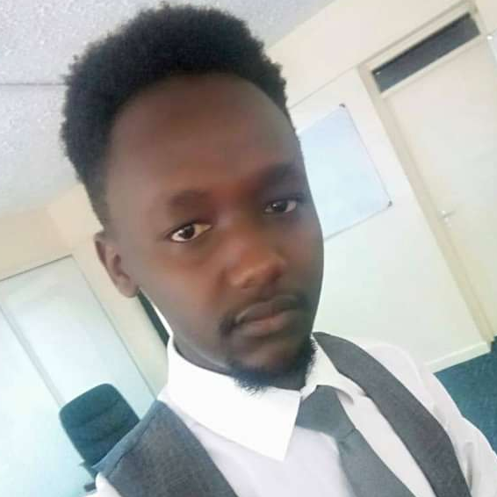
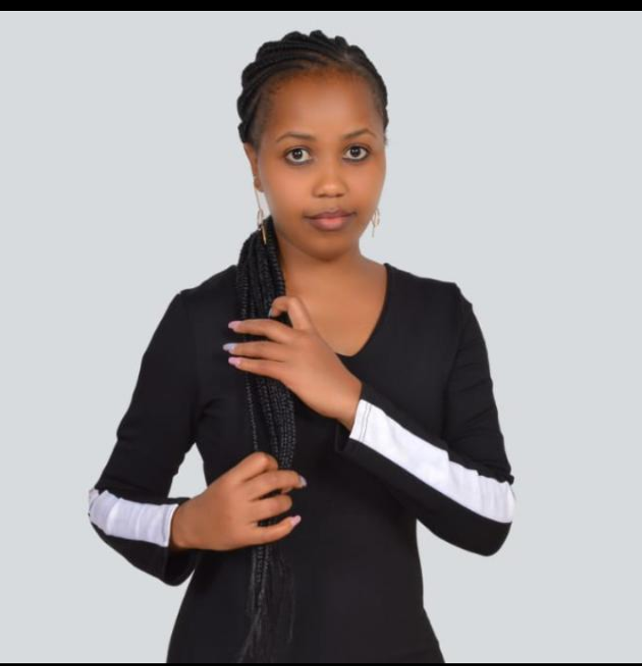
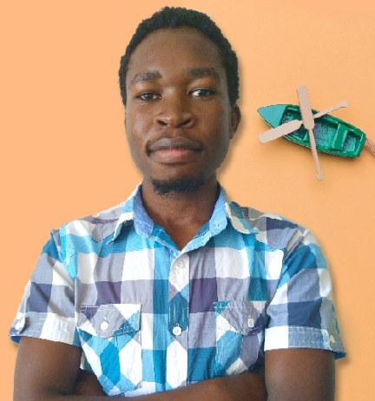
Our Core Team.
JOEL KIPKORIR . BRIAN BALIAT. MAUREEN KIBOI. ALLAN WAFULA.
Co-Founder & CEO. CTO Bsc Computer Sc . COO Bsc Actuarial Sc. Bsc I.T Designer.
Bsc Actuarial Sc.

Slide 11


